Slide 1
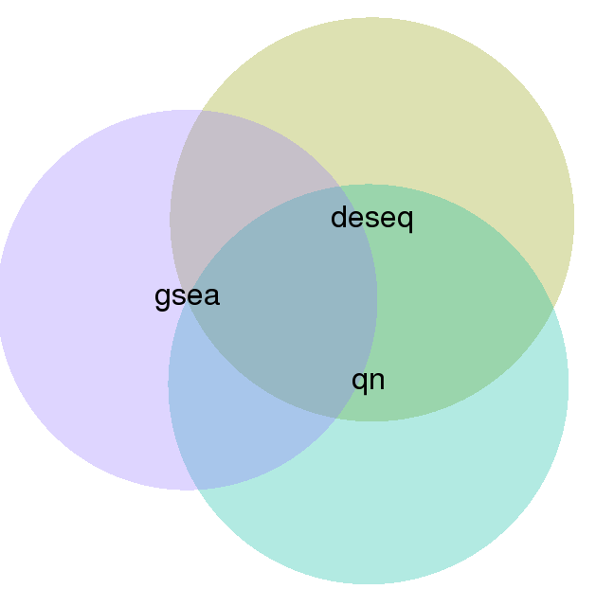
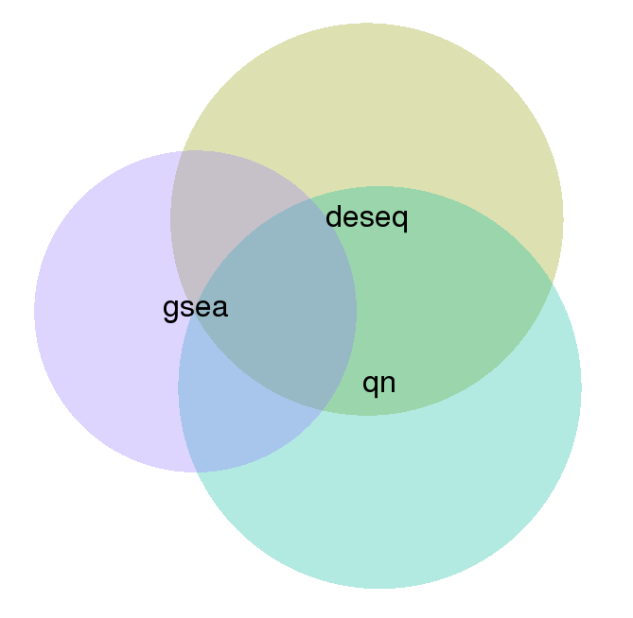
An Atlas of Chromatin Regulator Function During Effector and Memory CD8 T cell Development
Depleted from effector cells
Depleted from memory precursor cells
DEseq/QN = 63
DEseq/QN = 57
DEseq/GSEA = 37
DEseq/GSEA = 25
QN/GSEA = 37
34
22
QN/GSEA = 24
Total Genes: 108
Total Genes: 91
ARID1B
BRWD1
SMARCA2
SMARCA4
SMARCC1
SMARCD2
SMARCE1
BRD3
BRD4
DNMT3B
DNMT3L
GADD45A
GADD45B
DMAP1
HAT1
KAT2B
MYST1
MYST2
NCOA3
INO80
KDM2B
KDM3B
MTA3
CHD3
CHD4
CHD7
CHD9
TRIM28
ASXL1
BMI1
CBX5
CBX6
CBX7
EPC1
EPC2
EZH2
L3MBTL4
PCGF5
RNF2
SCML2
SCML4
PRDM1
PRDM16
PRDM4
PRDM5
PRDM6
PADI1
PADI4
RNF40
FBXL19
FBXO17
FBXO44
FBXW9
ELP4
PAF1
TET2
ACTL6B
PPARGC1A
ARID1A
SMARCC2
CHD8
HDAC1
HDAC10
HDAC2
HDAC3
HDAC8
JMJD1C
KDM1B
KDM3A
KDM4D
KDM5B
KDM5D
KDM6A
MBD1
MBD2
MBD3
MECP2
MLL1
MLL2
MLL3
MLL5
WDR5
BRD1
BRD2
BRDT
BRPF1
MTA1
MTA2
NCOR1
NCOR2
L3MBTL1
L3MBTL2
L3MBTL3
PHF19
PRDM10
PRDM11
PRDM12
PRDM13
PRDM14
PRDM15
PRDM8
PRDM9
CARM1
PRMT5
PRMT6
PRMT7
PRMT8
AFF1
RNF20
TET1
TET3
GTF2B
GTF2F1
GTF2H1
GTF3C4
TAF1
TAF3
BAF complex
Polycomb group
Histone
Demethylases
Prdms
Histone
Acetyltranferase
Peptidylarginine
deiminases
Methyl-Binding
DNA
Arginine
Methyltransferases
Mll complex
NuRD complex
General Transcription Factors

Slide 2
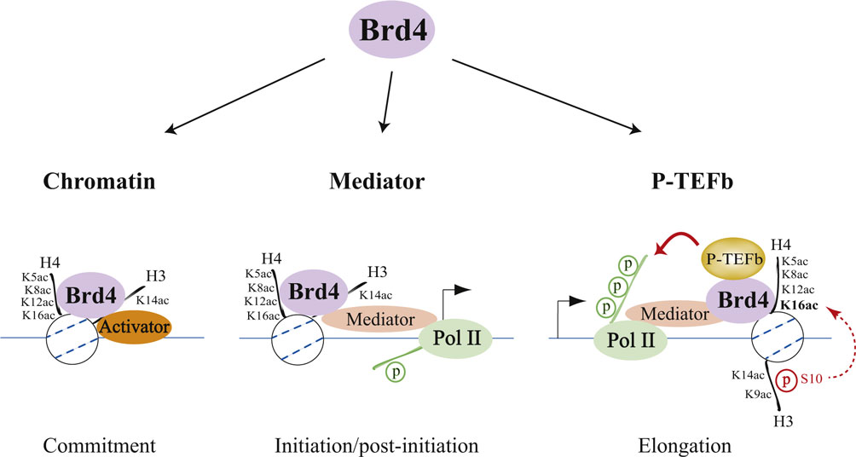
A role for Transcriptional Elongation During Effector and Memory CD8 T cell Formation?
shRNAs depleted from effector CD8 T cells
320 genes
~1,200 shRNAmirs
3-4 shRNAmirs/ gene
shBrd4.2
shBrd4.4
shCdk9.2
shBrd4.3
shCdk9.1
shBrd4.1
shCcnt1.1
shCcnt1.2
shCcnt1.3
Negative control shRNAs
Z-score (log₂ Memory/Effector)
shCcnt1.4
shCarm1.2
shCdk9.3
shPrmt5.4
shPrmt5.3
shPrmt5.2
shCarm1.1
shCarm1.3
shCarm1.4
shPrmt5.1
shRNAs depleted from memory precursor CD8 T cells

Slide 3
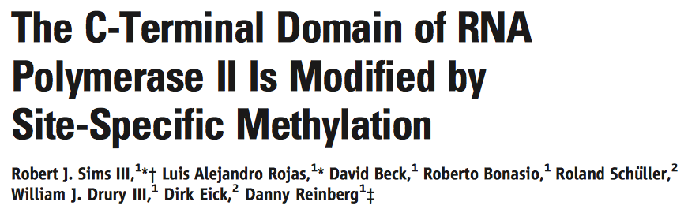
Carm1 methylates residue within the CTD of RNA Pol II
Function of methylation is unknow
Could methylation prevent phosphorylation?

Slide 4
shRNAs for Prmt5 enhance CD25 expression under low IL-2 conditions
Prmt5.1
Prmt5.3
Z-Score (based on all shRNAs)
shCd4.1
Prmt5.4
shPrmt5.4
shPrmt5.3
Prmt5.2
shPrmt5.2
shPrmt5.1
shCd4

Slide 5

shRNAs targeting Prmt5 inhibit memory precursor CD8 T cell differentiation
P14 cells+shRNAs-RV
Analyze 8 days
after infection
+ LCMV
shCd4.1
shPrmt5.1
shPrmt5.2
shPrmt5.3
shPrmt5.4
KLRG1
IL7Ra
Notes:
Percentage is messed up but also fewer absolute numbers of memory cells

Slide 6
Prmt5 KD impairs CD8 accumulation in vivo and in vitro

Slide 7
shRNAs targeting Prmt5 enhance in vivo T-bet expression
Relative Cell #
shPrmt5.2
shPrmt5.2
shCd4.1
shCd4.1
Naïve CD8
T-bet

Slide 8
shRNAs targeting Prmt5 enhance in vitro cytokine production
shPrmt5.2
Relative Cell #
Relative Cell #
Relative Cell #
shCd4.1
IFNg
TNFa
IL-2
Notes:
Blue-Prmt5

Slide 9
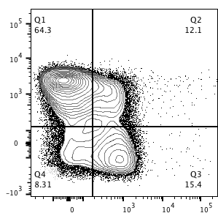
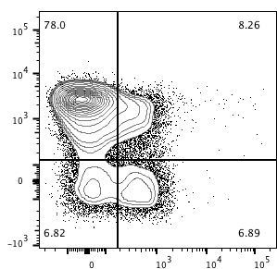
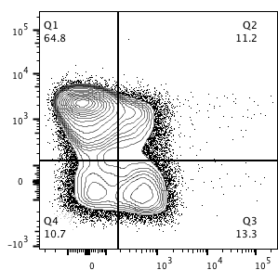
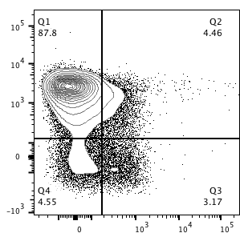
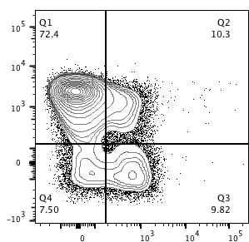
shRNAs targeting Carm1 inhibit memory precursor CD8 T cell differentiation
P14 cells+shRNAs-RV
Analyze 8 days
after infection
+ LCMV
shCd4.1
shCarm1.1
shCarm1.2
shCarm1.3
shCarm1.4
KLRG1
IL7Ra
Notes:
Carm1 KD

Slide 10
Summary
shRNAs targeting Prmt5 and Carm1 inhibit memory precursor CD8 T cell differentiation
shRNAs targeting Prmt5 enhance in vivo T-bet expression and in vitro IFNg and TNFa production
Currently working on…
RNA Pol II ChIP
Histone modification ChIP (highly transcribed/correlate with RNA pol II occupancy)
H3K4me3
H3K36me3

